Slide 1
U.S. Chronic Disease Indicators
A Comprehensive Overview
YARUQ HASSAN

Slide 2
Introduction to Chronic Diseases
Chronic diseases are long-lasting conditions with persistent effects.
Major causes of death and disability in the U.S.
Importance of Chronic Disease Indicators
Help monitor and understand public health trends.
Inform policy-making, resource allocation, and prevention strategies.
Do factors such as demographics, gender, ethnicity, or race play a role?

Slide 3

Data Cleanup in Python
Overview: Conducted several operations to clean a dataset containing over 250,000 records across 17 columns.
Handling Missing Data: Removed rows with missing or blank values and renamed columns for better clarity.
Results: After cleaning, the dataset was reduced to 158,419 records with 10 columns.

Slide 4
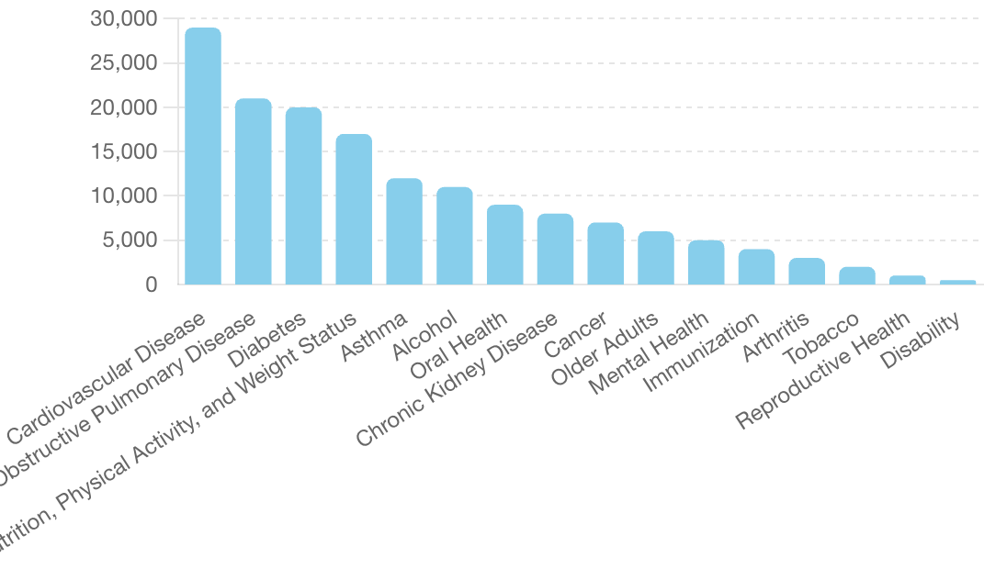
Top 3 Chronic Diseases in the U.S.
Cardiovascular Disease: 29,000 cases
Chronic Obstructive Pulmonary Disease: 21,000 cases
Diabetes: 20,000 cases

Slide 5

Prevalence of Cardiovascular Disease
29,000 cases reported in the U.S.
Data was limited but showed Mortality factors due to CVD.
Compared Gender, Race/Ethnicity and Demographics as potential factors

Slide 6
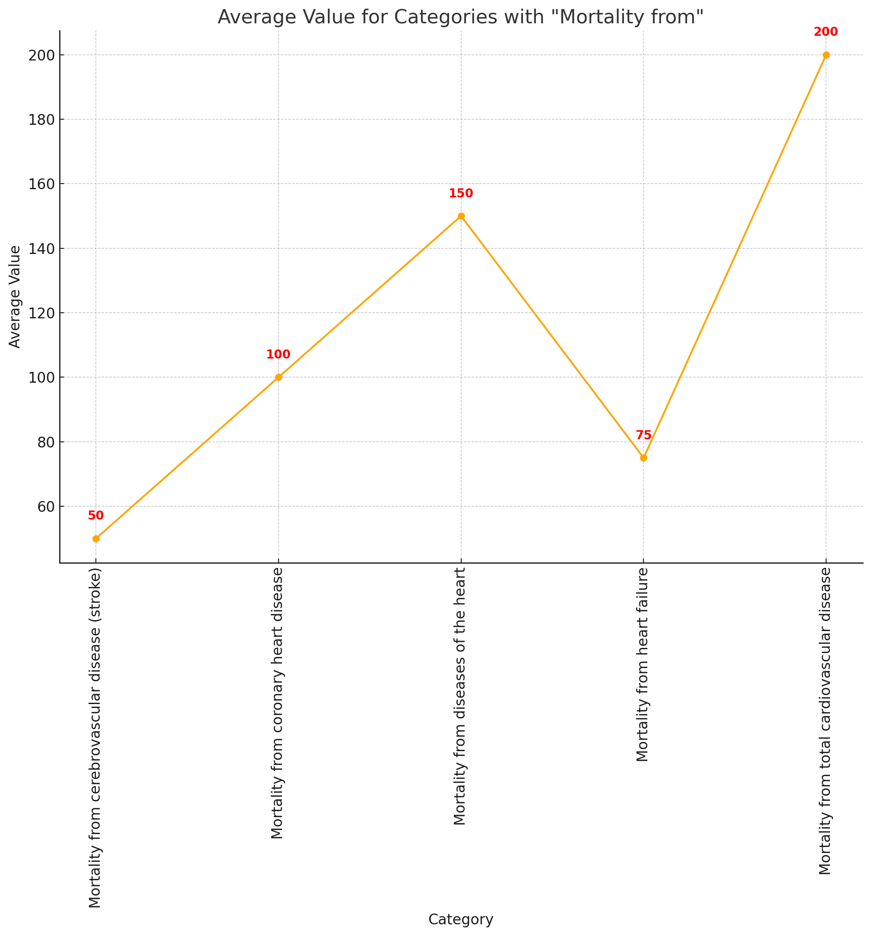
Mortality Factors in CVD

Slide 7
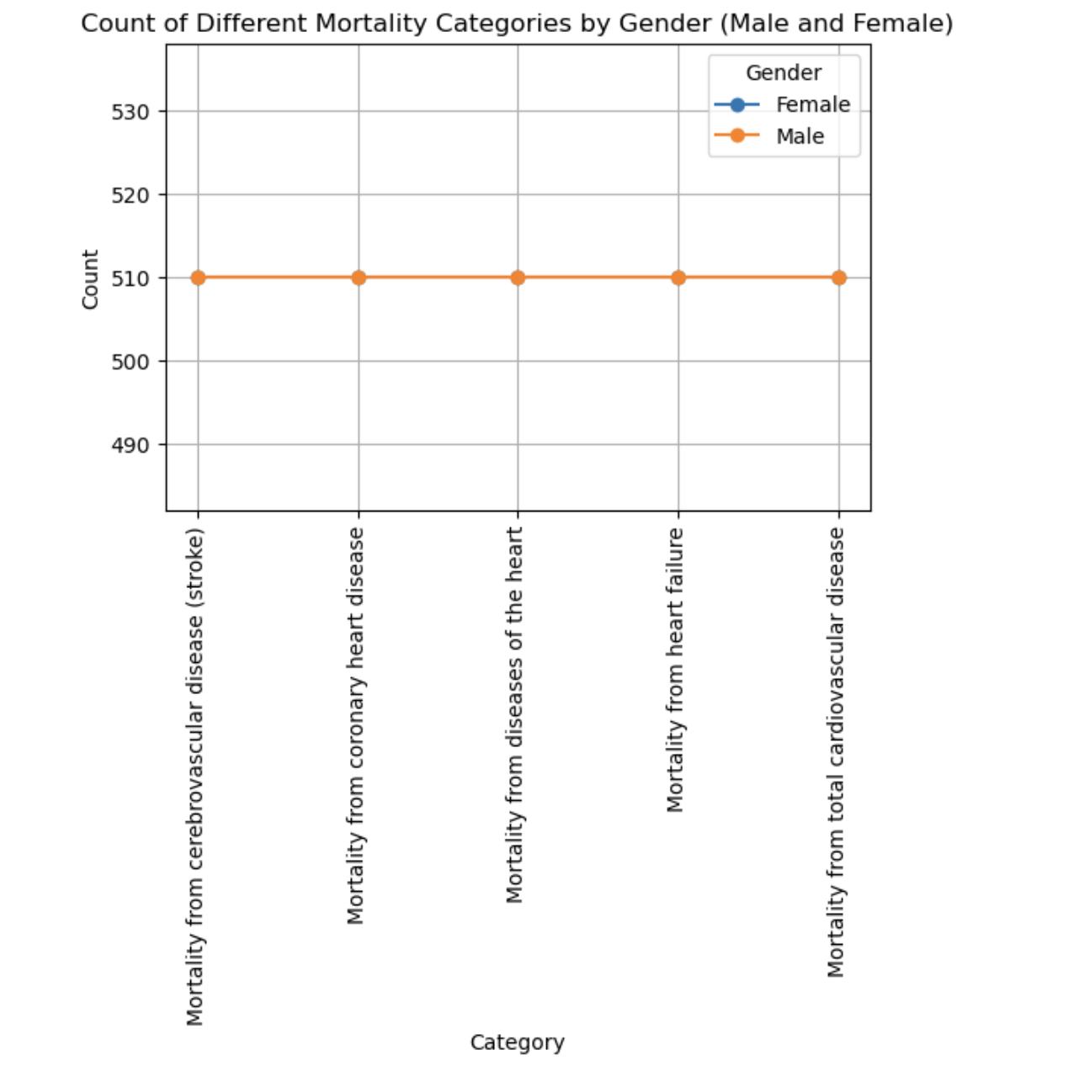
Gender Comparison in Cardiovascular Disease Mortality
Observations
Consistency: The counts for males and females in all categories are remarkably similar, suggesting uniform mortality rates across genders for these conditions.
Implications: Indicates that both genders are equally affected by cardiovascular diseases in terms of mortality.
Conclusion:
Equal Impact: Cardiovascular diseases pose a similar mortality risk for both men and women, highlighting the importance of targeted prevention and treatment efforts for all populations.

Slide 8
Mortality Counts by Race/Ethnicity
Key Insights:
White, non-Hispanic consistently shows high mortality counts across all categories.
American Indian or Alaska Native has the lowest counts in most categories.
Hispanic populations have varied counts, with notably lower counts in stroke and higher in coronary heart disease.
Black, non-Hispanic shows significant counts, particularly in stroke and heart failure.
Implications: Identifying these disparities can help target public health interventions more effectively to the communities most at risk.

Slide 9
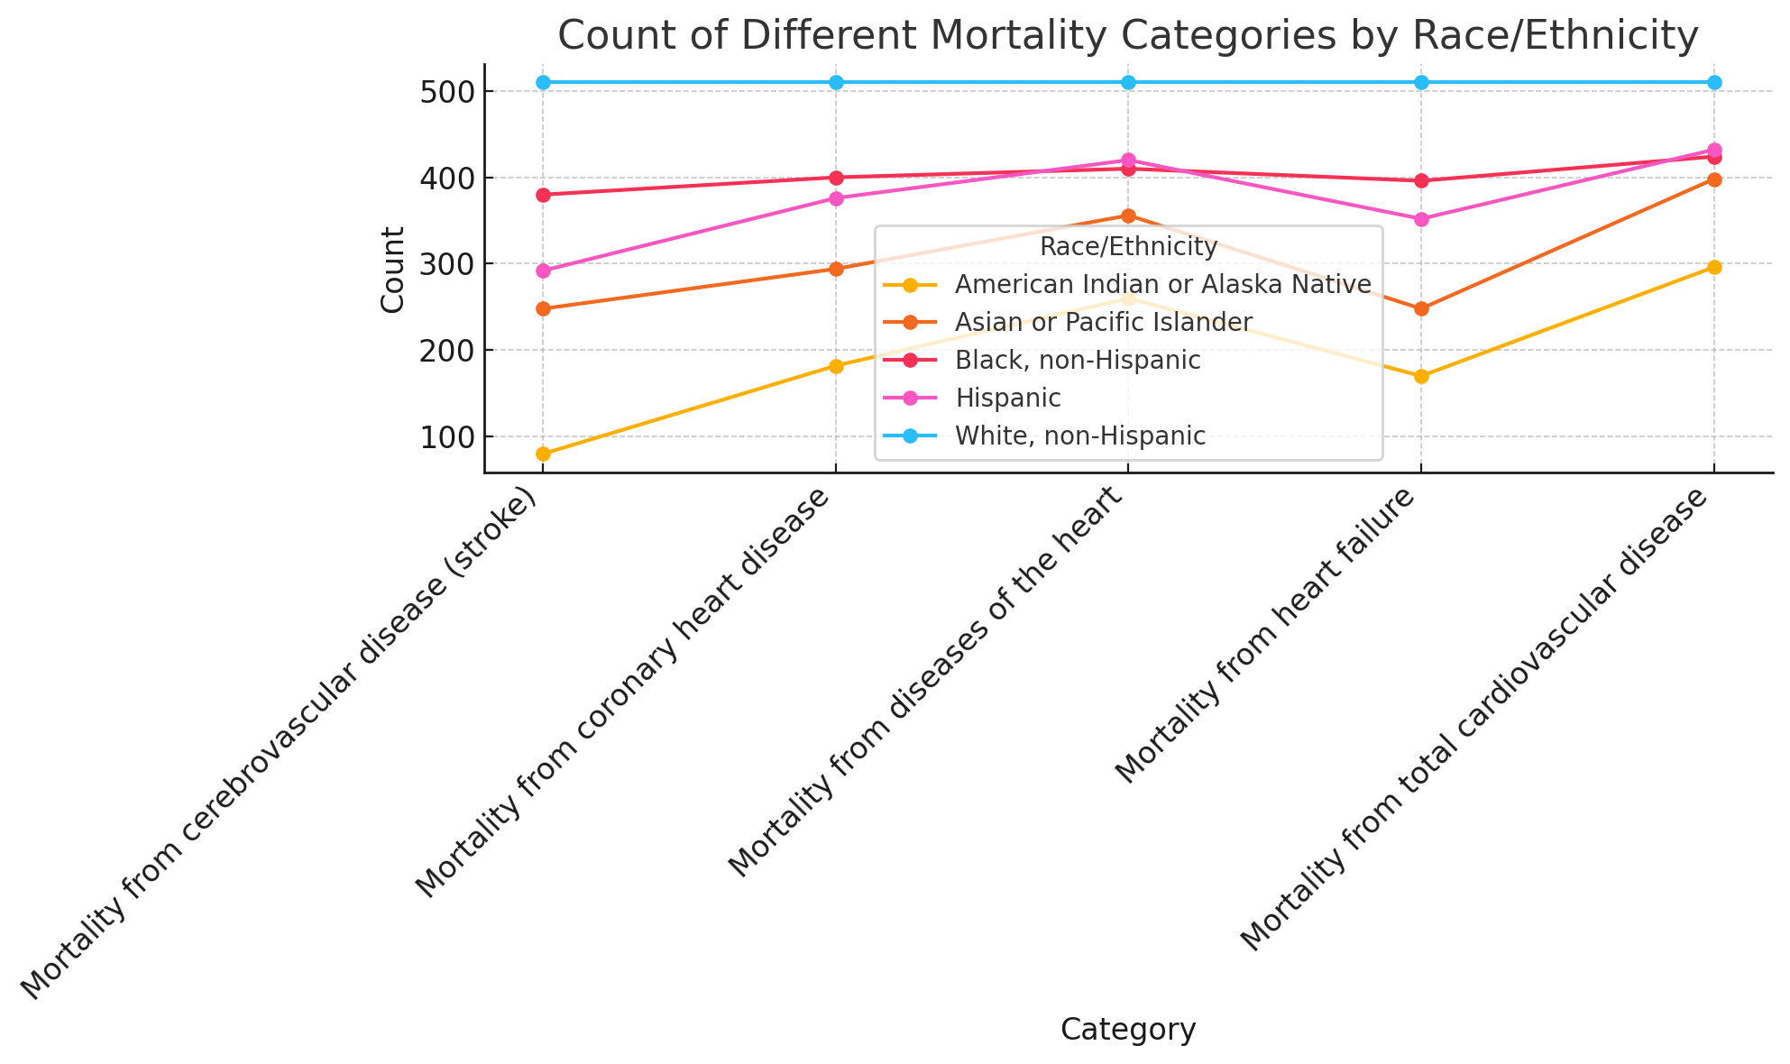
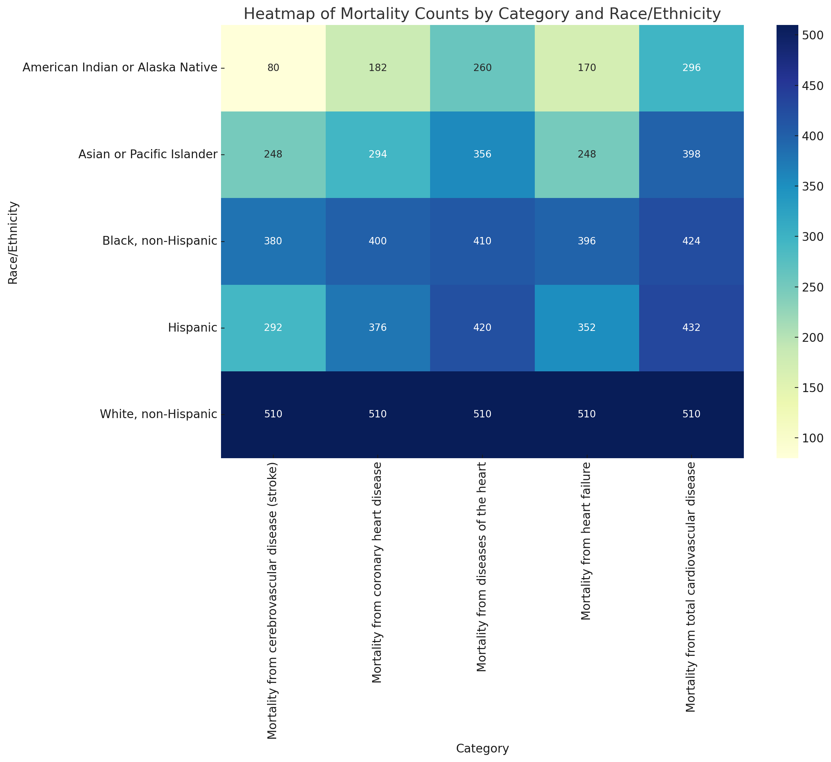
Mortality Counts by Race/Ethnicity
Key Insights:
White, non-Hispanic consistently shows high mortality counts across all categories.
American Indian or Alaska Native has the lowest counts in most categories.
Hispanic populations have varied counts, with notably lower counts in stroke and higher in coronary heart disease.
Black, non-Hispanic shows significant counts, particularly in stroke and heart failure.
Implications: Identifying these disparities can help target public health interventions more effectively to the communities most at risk.

Slide 10
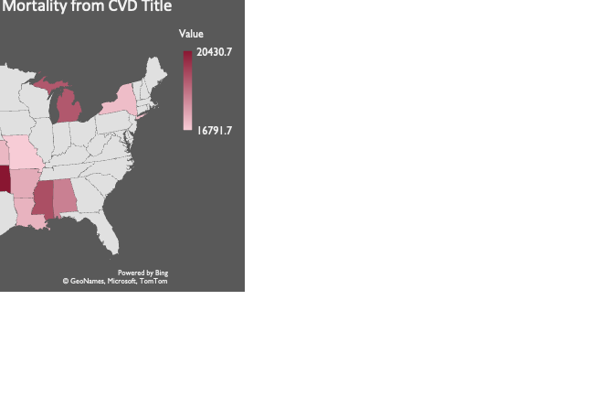
Top 10 States with Mortality from Cardiovascular Disease
Regional Variations: States like Oklahoma and Mississippi have significantly higher mortality rates from cardiovascular disease.
Implications: Indicates the need for targeted public health interventions in these states.
There is a considerable variation in cardiovascular disease mortality across different states.
Focus on prevention and treatment efforts in states with higher mortality rates to reduce overall cardiovascular disease burden.

Slide 11
Bottom 4 States with Mortality from CVD
Lower Mortality Rates: States like New Hampshire and Wyoming have significantly lower mortality rates from cardiovascular disease compared to other states.
Implications: Indicates potentially better healthcare access, prevention measures, or lower prevalence of risk factors in these states.
Conclusion
Utilize insights from states with lower mortality rates to develop and apply effective prevention and treatment strategies on a national scale.

Slide 12

Conclusion
Data Quality: The data is not clean and requires some improvement.
Leading Chronic Disease: According to the provided data, cardiovascular diseases top the chart as the leading chronic diseases in the U.S.
State Leading Mortality Factors: The leading factor is mortality from total cardiovascular disease, followed by diseases of the heart, coronary heart disease, heart failure, and stroke.
Mortality Rates: Oklahoma has the highest mortality rate, while New Hampshire has the lowest.
Gender Rates: Gender impact is equal.
Demographic Insights:
White, non-Hispanic shows consistently high mortality.
American Indian or Alaska Native has the lowest counts.
Hispanic counts vary, lower in stroke, higher in coronary heart disease.
Black, non-Hispanic shows high counts in stroke and heart failure.

